Slide 1

Academic Session 2025-26
EVEN Semester Jan-Jun 2026
UNIVERSITY INSTITUTE OF ENGINEERING
AIT-CSE
B.E CSE
AIML/ 6th
SOFTWARE ENGINEERING
23CSH-374
Faculty Name : Dr Geeta Rani CUmail-ID : geeta.e15227@cumail.in
Designation : Associate Professor

Slide 2
Course Objectives
Understand fundamental software engineering processes, SDLC models, and requirement engineering techniques used in real-world projects.
Apply modeling concepts, design principles, and UML diagrams to represent system structures and behaviors effectively.
Analyze various software development, design, and testing strategies to determine their suitability for different project scenarios.
Evaluate software solutions and project management practices based on quality metrics, design principles, and testing outcomes.
Create structured requirement documents, UML models, test plans, and project management artifacts for medium-scale software systems.

Slide 3

Course Outcomes
CO No. | Statement
CO1 | Explain SDLC models, requirement principles, testing strategies, and project management concepts.
CO2 | Construct UML diagrams and apply design patterns to solve software design problems
CO3 | Compare SDLC models, testing strategies for different scenarios.
CO4 | Assess testing strategies, maintenance approaches, and project metrics to ensure software quality.
CO5 | Develop complete requirement specifications, design models, test plans, and project management documents (including Jira-based defect tracking) for real-world case studies

Slide 4
Suggestive Readings
Text Books:
Pressman, R. S., “Software Engineering: A Practitioner’s Approach,” McGraw Hill.
Ian Sommerville, “Software Engineering,” Pearson.
Reference Books:
Pankaj Jalote, “An Integrated Approach to Software Engineering,” Narosa.
Ghezzi, Jazayeri, Mandrioli, “Fundamentals of Software Engineering,” PHI.

Slide 5
Unit-I Syllabus
Unit-1 | Unit 1: Software Process and Requirement Engineering (15 hours)
Chapter 1.1 | Software Engineering: Introduction, SDLC, Agile vs Traditional models.
Chapter 1.2 | Requirement Engineering: Elicitation, Analysis, Specification, Validation.
Chapter 1.3 | Case Studies: Requirements in online payment systems.

Slide 6
Table of Contents
Basic Definitions
Software vs Program
Types of software
Issues /Challenges
Attributes Of Good Software
Introduction to Software Engineering
Principles of Software Engineering
Summary

Slide 7
Basic Definitions
Program: Set of instructions for a specific task
Software: Collection of programs + data + documents
Software Engineering: Structured approach to software development

Slide 8
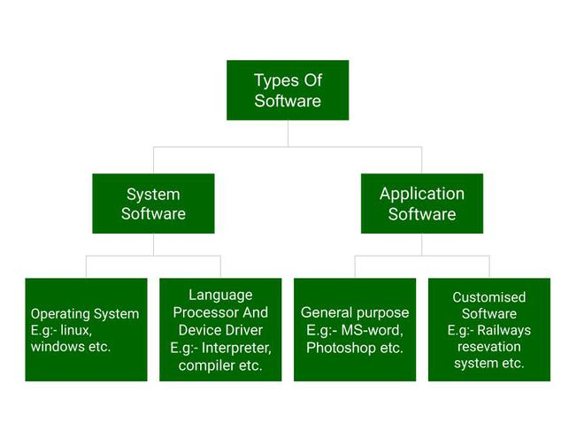
Types of Software

Slide 9
Software products
Generic products
  Stand-alone systems that are marketed and sold to any customer who wishes to buy them.
  Examples – PC software such as graphics programs, project management tools; CAD software; software for specific markets such as appointment systems for dentists.
Customized products
  Software that is commissioned by a specific customer to meet their own needs.
  Examples – embedded control systems, air traffic control software, traffic monitoring systems.

Slide 10
Product specification
Generic products
  The specification of what the software should do is owned by the software developer and decisions on software change are made by the developer.
Customized products
  The specification of what the software should do is owned by the customer for the software and they make decisions on software changes that are required.

Slide 11
General Issues That Affect Software
Heterogeneity
  Increasingly, systems are required to operate as distributed systems across networks that include different types of computer and mobile devices.
Business and social change
  Business and society are changing incredibly quickly as emerging economies develop and new technologies become available. They need to be able to change their existing software and to rapidly develop new software.

Slide 12
General Issues That Affect Software
Security and trust
  As software is intertwined with all aspects of our lives, it is essential that we can trust that software.
Scale
  Software has to be developed across a very wide range of scales, from very small embedded systems in portable or wearable devices through to Internet-scale, cloud-based systems that serve a global community.

Slide 13
Software Engineering Diversity
There are many different types of software system and there is no universal set of software techniques that is applicable to all of these.
The software engineering methods and tools used depend on the type of application being developed, the requirements of the customer and the background of the development team.

Slide 14
Essential Attributes Of Good Software
Product characteristic | Description
Maintainability | Software should be written in such a way so that it can evolve to meet the changing needs of customers. This is a critical attribute because software change is an inevitable requirement of a changing business environment.
Dependability and security | Software dependability includes a range of characteristics including reliability, security and safety. Dependable software should not cause physical or economic damage in the event of system failure. Malicious users should not be able to access or damage the system.
Efficiency | Software should not make wasteful use of system resources such as memory and processor cycles. Efficiency therefore includes responsiveness, processing time, memory utilisation, etc.
Acceptability | Software must be acceptable to the type of users for which it is designed. This means that it must be understandable, usable and compatible with other systems that they use.

Slide 15
Software Engineering
Software engineering is a systematic, disciplined, and quantifiable approach to the design, development, operation, and maintenance of software. It is the application of engineering principles to software creation to ensure the resulting product is reliable, efficient, and meets user requirements within time and budget constraints

Slide 16
Software Engineering
Software engineering is an engineering discipline that is concerned with all aspects of software production from the early stages of system specification through to maintaining the system after it has gone into use.
Engineering discipline
  Using appropriate theories and methods to solve problems bearing in mind organizational and financial constraints.
All aspects of software production
  Not just technical process of development. Also project management and the development of tools, methods etc. to support software production.

Slide 17
Why Software Engineering
Manage complexity
Improve quality
Reduce development time
Ensure maintainability

Slide 18
Software Engineering Fundamentals
Some fundamental principles apply to all types of software system, irrespective of the development techniques used:
  Systems should be developed using a managed and understood development process. Of course, different processes are used for different types of software.
  Dependability and performance are important for all types of system.
  Understanding and managing the software specification and requirements (what the software should do) are important.
  Where appropriate, you should reuse software that has already been developed rather than write new software.

Slide 19
Internet Software Engineering
The Web is now a platform for running application and organizations are increasingly developing web-based systems rather than local systems.
Web services allow application functionality to be accessed over the web.
Cloud computing is an approach to the provision of computer services where applications run remotely on the ‘cloud’.
  Users do not buy software buy pay according to use.

Slide 20
Web-based software engineering
7
Web-based systems are complex distributed systems but the fundamental principles of software engineering discussed previously are as applicable to them as they are to any other types of system.
The fundamental ideas of software engineering apply to web-based software in the same way that they apply to other types of software system.

Slide 21
Core Activities
Software engineering encompasses the entire software development life cycle (SDLC), which involves several key activities:
Requirements Analysis: Collaborating with stakeholders to understand and document the desired functions and constraints of the software.
Design: Creating a high-level blueprint for the software architecture, defining components, data structures, and interfaces.
Implementation (Coding): Writing the actual program code in appropriate languages based on the design specifications.

Slide 22
Core Activities
Software engineering encompasses the entire software development life cycle (SDLC), which involves several key activities:
Testing: Verifying that the software meets its requirements and is free of bugs and errors through various testing levels (unit, integration, system, etc.).
Maintenance: Regularly updating, modifying, and enhancing the software after deployment to fix bugs, adapt to new environments, and add new features.
Project Management: Planning, monitoring, and controlling the software project to manage scope, cost, time, and quality.

Slide 23
Principles of Software Engineering
Unlike simple programming, which can be an informal activity, software engineering relies on established principles to manage complexity and ensure quality, especially for large and intricate systems:
Modularity: Breaking down complex software into smaller, manageable components.
Abstraction and Encapsulation: Hiding implementation details to simplify interaction and protect internal data.
Reusability: Designing components that can be used across multiple projects to save time and resources.

Slide 24
Principles of Software Engineering
Unlike simple programming, which can be an informal activity, software engineering relies on established principles to manage complexity and ensure quality, especially for large and intricate systems:
Quality Focus: Applying rigorous testing and quality assurance practices throughout the entire process.
Systematic Approach: Following structured methodologies (like Agile or Waterfall) to guide development from conception to retirement.

Slide 25
Summary
7
Software engineering is an engineering discipline that is concerned with all aspects of software production.
Essential software product attributes are maintainability, dependability and security, efficiency and acceptability.
The high-level activities of specification, development, validation and evolution are part of all software processes.
The fundamental notions of software engineering are universally applicable to all types of system development.

Slide 26
Quiz/ FAQ’s
How is software different from a program?
What are the main activities involved in software engineering?
What is the difference between a software engineer and a programmer?

Slide 27
Faculty-curated videos, NPTEL, Coursera, LinkedIn, or other relevant learning resources
NPTEL — “Software Engineering” course from IIT Kharagpur / Indian Institutes https://onlinecourses.nptel.ac.in/noc25_cs108/preview?utm_source=chatgpt.com
nptelhrd (IIT/Bombay) — Lecture series “Introduction to Software Engineering” (free video lecture) https://www.youtube.com/watch?v=Z6f9ckEElsU&utm_source=chatgpt.com
CS & IT Tutorials by Vrushali — “SE 1: Learn Software Engineering from Scratch” (YouTube) https://www.youtube.com/watch?v=IHx9ImEMuzQ
Coursera – Introduction to Software Engineering (IBM) https://www.coursera.org/learn/introduction-to-software-engineering

Slide 28
Next lecture
Software development life cycle (SDLC)
SDLC Models

Slide 29

11
Class-Wise Feedback

Slide 30
Thank You
For queries
Email: geeta.e15227@cumail.in

